Slide 1
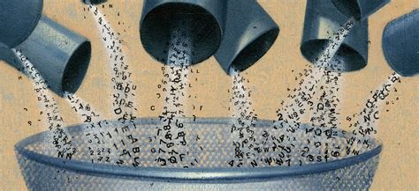
The datafied self and surveillance capitalism
CT5142 AI and Ethics, Week 8

Slide 2
Content
The datafied self
Surveillance capitalism

Slide 3
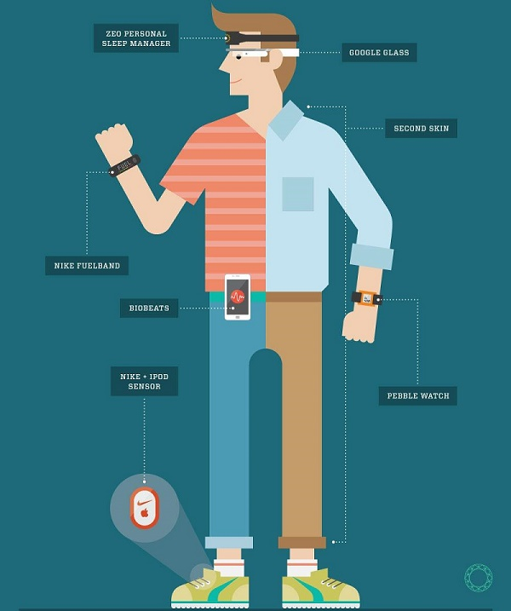
Digitalisation of daily life
facilitated by ubiquity of mobile devices and the multiplicity of our activities and other parameters that can be easily tracked
Leading to collection of ever more fine-grained and voluminous information about ourselves and our activities

Slide 4
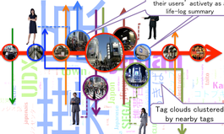
Tracking and data analysis
ongoing passive tracking of complex parameters leads to increase in the amount of information tracked
digital data from large numbers of people is available, either through deliberate sharing or through background collection by companies
Interpreting this data poses challenges, requiring new forms of data quality assurance, data analysis and integration of diverse datastreams
Potentially unprecedented insights into human psychology and action

Slide 5

The quantified self
“The quantified self (QS) is any individual engaged in the self-tracking of any kind of biological, physical, behavioral, or environmental information. There is a proactive stance toward obtaining information and acting on it.” (Swan 2013)
“Quantified Self (QS) is the term that embodies self-knowledge through self-tracking. … QS really revolves around finding personal meaning in your personal data.” (Quantified Self Institute, https://qsinstitute.com/about/what-is-quantified-self/)
Swan, M. (2013). The quantified self: Fundamental disruption in big data science and biological discovery. Big Data, 1(2), 85-99.

Slide 6

Datafication
Kitchin (2014) on data: “digital objects derived through the reduction and extraction of social and cultural phenomena from observations, computations, experiments, and record keeping”
‘Datafication’ as rendering of human experience into (primarily digital) data sets, and the increasing trend to measure social life in numbers
especially the translation of qualitative information into quantifiable form, that can be easily collated, analysed and presented through information technologies.

Slide 7

Digital doubles
‘data doubles’ or ‘digital doubles’: data assemblages that represent the person whose characteristics are being captured by data
Engagement of self with digital double as raising specific issues
Ruckenstein (2014): “the conversion of human bodies and minds into data flows that can be figuratively reassembled for the purposes of personal reflection and interaction” (p.68)

Slide 8
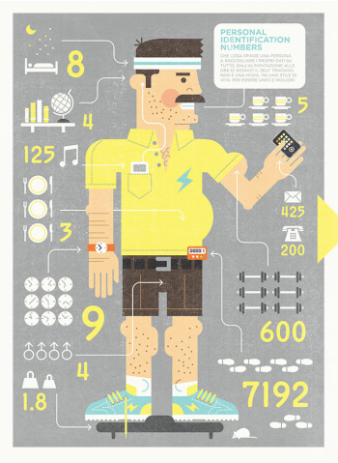
Data doubles, the self and others
reduction of experience merely to whatever can be captured as data by currently available means
Narrowing of self-focus: Attitude to self and its experience might change if subjective experience is more and more enhanced by quantifiable data
E.g. fitness or well-being as a set of numbers
Reductive data doubles: If others see you only through data, they get a potentially skewed picture of you
Data doubles tailored for external purposes: Other may collect data on you that suits their purposes vis-à-vis yourself, but maybe not be consistent with your own

Slide 9
Example: “Quantified sex” (Lupton 2014)
New ways of quantifying and gamifying sexual experience and behaviour via apps
Quantification: documenting date and number of sexual encounter, geographical location, type, frequency, length of sexual activity, calories used, sort the data by partner, date or sexual position,
Gamification: compare scores within region
“These technologies … act to support and reinforce highly reductive and normative ideas of what is ‘good sex’ and ‘good performance’ by encouraging users to quantify their sexual experiences and feelings in ever finer detail and to represent these data visually in graphs and tables.”
Data flows and privacy concerns
Lupton, D. (2015). Quantified sex: a critical analysis of sexual and reproductive self-tracking using apps. Culture, health & sexuality, 17(4), 440-453.

Slide 10

Quantification, gamification & behaviour change
Quantifying the self opens it up to gamification
Whitson (2013): “gamification is play applied to non-play spaces”; it “promise[s] to make real life more like a game”
data can be monitored, feedback can be given and users can be incentivised to keep up behaviour or change behaviour through rewards, use of leader boards etc.
Grey areas between gamification, nudging and manipulation

Slide 11
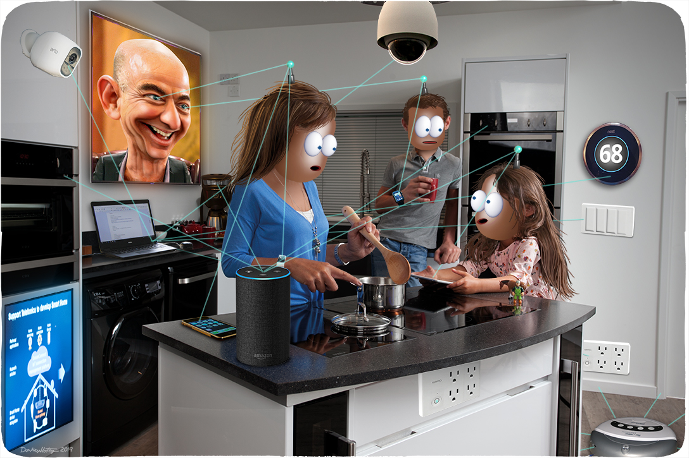
Surveillance capitalism

Slide 12
Self-surveillance, co-veillance and surveillance
Self-tracking as self-surveillance, i.e. observing and trying to control oneself
Co-veillance, i.e. observing of self by actively invited peers in a community, including attempts to influence behaviour of peers
Surveillance, i.e. observing of self by third parties, with aim to keep track of, potentially control and “discipline” others

Slide 13


Shoshana Zuboff: The Age of Surveillance Capitalism
Book dedicated to reflection on the nature of the interaction between big internet companies and individual users
Argues that this relationship is characterized by new ways of exercising power in asymmetric relationships between user and online service provider
At core of this power is combination of (i) unprecedented level of intimate surveillance and (ii) integration of the surveillance instrument with behavioural manipulation opportunities for monetary gain

Slide 14
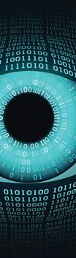
Surveillance capitalism as the mutually reinforcing feedback loop between:
Surveillance:
- collection of information that allows to predict and influence behaviour
- increased ability to benefit financially from results of surveillance
Capitalism:
- accumulation of wealth
- increased ability to invest in development of further surveillance and influencing mechanisms

Slide 15
Big internet companies are financially successful by:
Tracking your actions
Creating your detailed profile
Manipulating your behaviour to make money

Slide 16

Aim: uncovering underlying capitalist logic
Argues that what looks like company privacy breaches and overreach are not accidental and unfortunate, but deliberate and brazen results of a system that views users merely as a potential revenue stream to be optimised
This system operates by comprehensively surveilling and datafying users’ life:
“The result is that both the world and our lives are pervasively rendered as information… Whether you are complaining about your acne or engaging in political debate on Facebook, searching for a recipe or sensitive health information on Google, ordering laundry soap or taking photos of your nine-year-old, smiling or thinking angry thoughts, watching TV or doing wheelies in the parking lot, all of it is raw material” [that informs the companies’ actions vis-à-vis their users]

Slide 17
Predictions about our behaviour are the product
Core product of these companies: monetizeable prediction of your behaviour, traded in „behavioural futures markets“
Risk: loss of users‘ freedom through unprecedented level of knowledge and access for hidden manipulation
Aims: increase users‘ behaviour in line with predictions = „behavioural modification“ (which in the past was condemned as undemocratic)
Do companies have the right to what my future will be?

Slide 18
“Instrumentarian power knows and shapes human behaviour towards others’ ends”
Treating human beings as mere tools to achieve increased profits
Working through a ubiquitous, automated computational network of smart devices
Move from knowledge to behavioural modification with continuous intensification of the means of behavioural modification
Further supported by lack of precedents and context of security interestst after 9/11

Slide 19
Asymmetries of knowledge and power
Surveillance capitalists know everything about us
Their operations are unknowable to us
Accumulate vast new knowledge from us
Do not accumulate this new knowledge for us

Slide 20
„Our private experience is free for the taking as raw material“
Our intimate experiences become the companies‘ raw material: predictions based on users‘ data provided during use of services (extraction of behavioural surplus)
Unprecedented logic of appropriation of user data: Companies claimed ownership of user data without meaningfully asking permission or compensating users for the fair value of the data
Established through a continuous process of pushing boundaries of what used to be ownership relation of users to their data

Slide 21
Example: Smart Home (Zuboff 2019)
Vision of the Smart Home in 2000: assumption that all user data will remain private to user, fully controlled by user
Reality of the Smart Home in 2019 (e.g. with Nest): an intransparently interconnected set of companies has access to the user data that is shared widely for wide range of purposes (potentially 1000 contracts involved); only wholesale acceptance possible

Slide 22
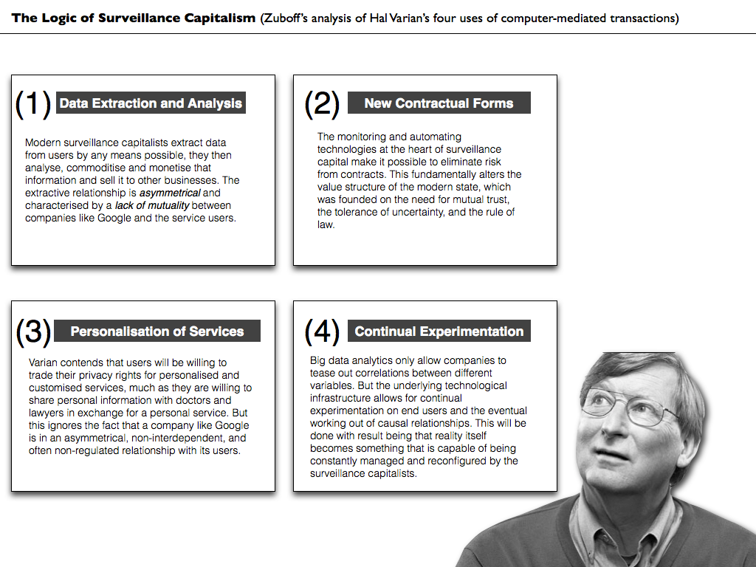
From John Danaher‘s blog Philosophical Disquisitions

Slide 23
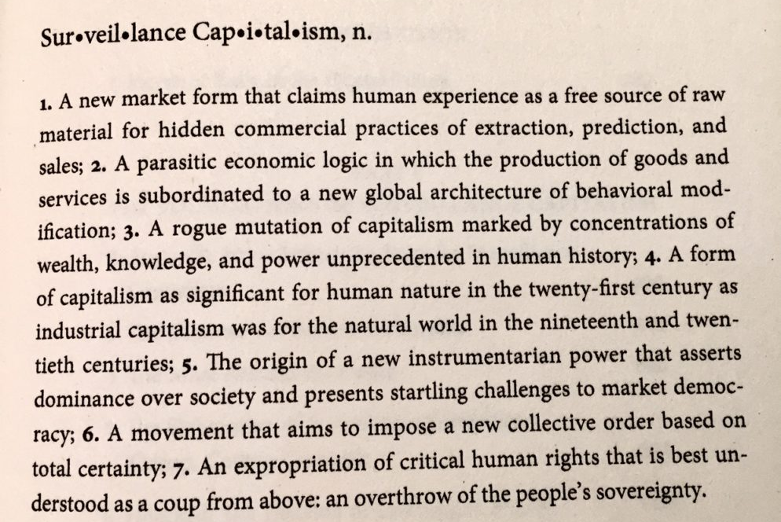
Summary Definition of Surveillance Capitalism

